Slide 1


MAULANA AZAD NATIONAL INSTITUTE OF TECHNOLOGY
TWITTER SENTIMENT
ANALYSIS
UNDER THE GUIDANCE OF:​
DR. GHANSHYAM SINGH THAKUR
Presented By: -​​
Parvati sidu(212120030)
Navin kumar Sinku(212120049)
sunny Horo(212120055)

Slide 2

CONTENT INDEX
INTRODUCTION
OBJECTIVE
FLOW CHART
MATERIAL AND METHODS
MODELS
RESULTS
MODEL EVALUATION
CONCLUSION

Slide 3

SENTIMENT ANALYSIS
Senti ment analysis is the process of determining the sentiment behind the tweets, whether a piece of written tweet is positive, neutral or negative. it's also called opinion mining.
it's a really useful analysis since we could possibly determine the overall opinion about a selling object, or predict stock markets for the given company.

Slide 4
APPLICATION
1
BUSINESS
To understand customers' feeling towads product and brands.
2
POLITICS
Keep track of political view, to detect consistency and inconsistency between statements of the political parties.
3
PUBLIC ACTIONS
Monitor and analyse social phenomena.

Slide 5

OBJECTIVE
1
Sentiment Analysis to determine the attitude of the mass is +ve,-ve or neutral.
Graphical representation of the sentiment in form of confusion matrix,ROC-AUC curve,etc.
2
3
To find the machine learning algorithm that best fits the twitter data set.
4
To achieve the accuracy of our model greater than 95%.

Slide 6
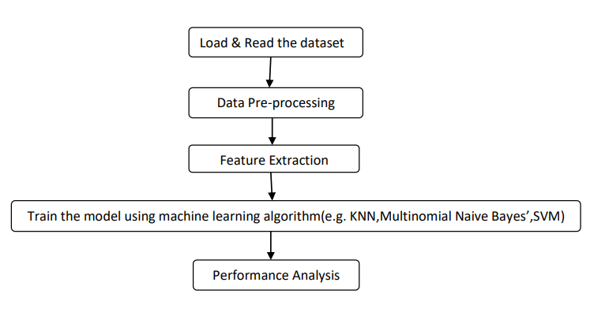
PROCESS FLOWCHART

Slide 7

SOURCE OF TWITTER DATA SET
HTTPS://WWW.KAGGLE.COM/DATASETS/JP797498E/TWITTER-ENTITY-SENTIMENT-ANALYSIS
Twitter sentiment Analysis Dataset is taken from Kaggle Website that consists 69491 of rows and 4 columns.
Tweet id: Unique id of the tweet.
Entity: It represents the type of game.
Sentiment: the polarity of the tweet (positive, negative or neutral).
Tweet content: It refers to the text of the tweet.

Slide 8
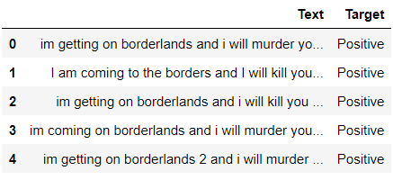
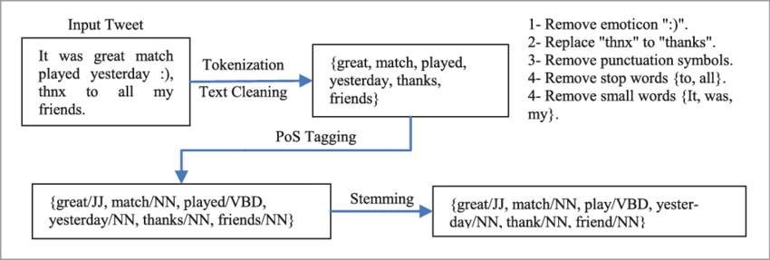
2.DATA PREPROCESSING
(a). Remove unnecessary columns(features) from data frame that do not contribute in determining the sentiment of the twitter text.
(b).drop duplicate data from the data frame

Slide 9
"I"
"love"
"this"
"game
1
TOKENIZATION
I love this game
TOKENIZATION
2
REMOVE PUNCTUATION
Punctuation marks, such as commas(,), periods(.), and question marks(?), can add clarity and structure to text when we read it, but they can also add noise when we try to analyze or process text computationally.
3
STOPWORDS
"the", "and", "a", "an", "in", "of", and "to".

Slide 10
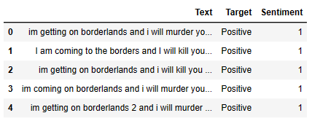
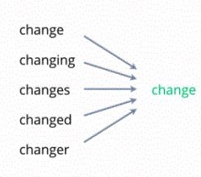
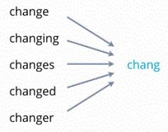
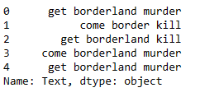
4
LEMMATIZE
Before cleaning
5
STEMMING
After cleaning

Slide 11
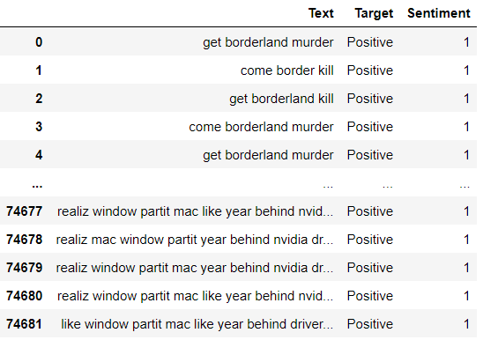
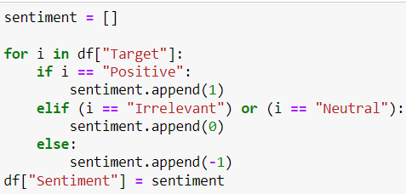
3.FEATURE EXTRACTION
Since our machine cannot understand text data,therefore we have to convert text data into numerical data.
Sentiment column is added

Slide 12
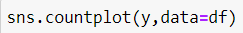
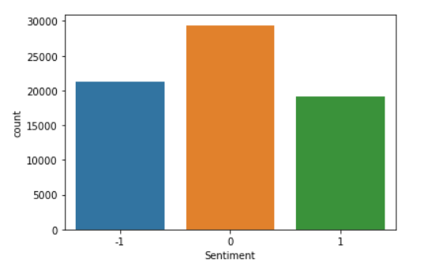

Slide 13
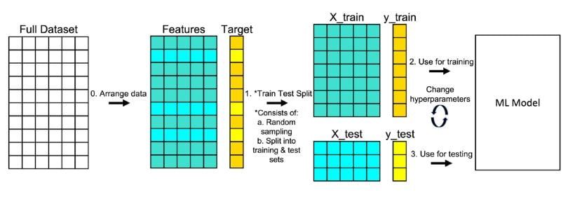
e.g. of Train_Test_Split :
(a)Vectorization:We use count vectorizer to convert the text column into numerical form

Slide 14
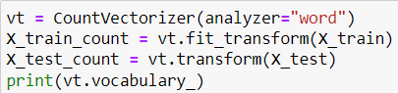
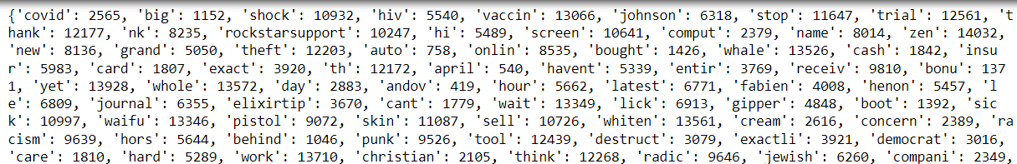
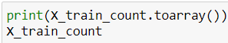
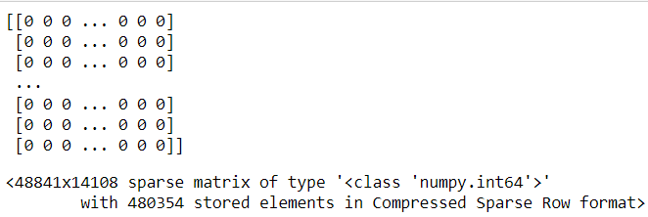

Slide 15
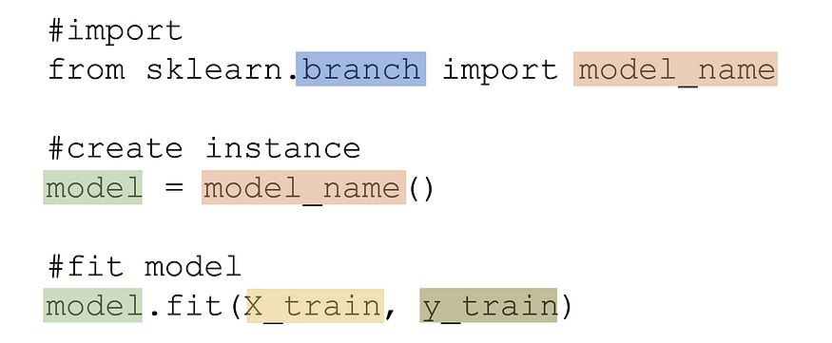
4.Train the model using classification algorithm
(a)
#We train the model using fit() function
(b)Now,our model will predict the sentiment based training data(x_train) as well as testing data(x_test)

Slide 16
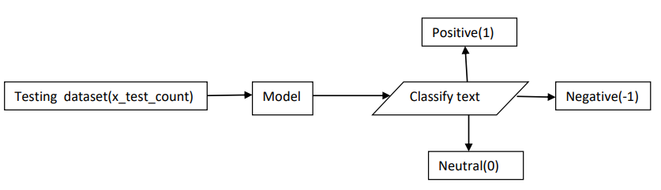
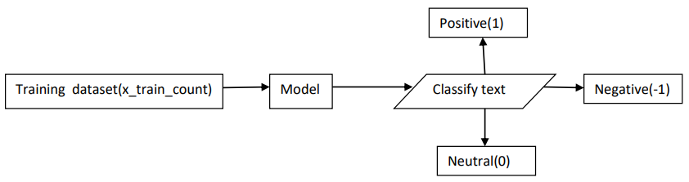
y_test_prediction=model_name.predict(x_test_count)
y_train_prediction=model_name.predict(x_train_count)

Slide 17
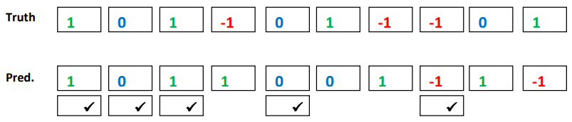
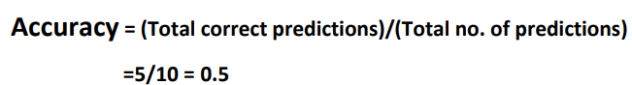
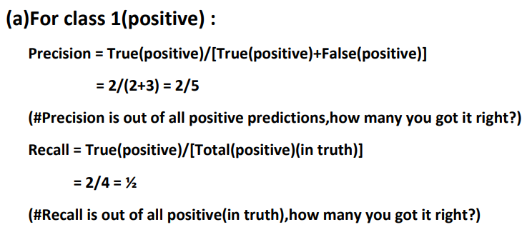
Performance Metrics(Explaination)

Slide 18
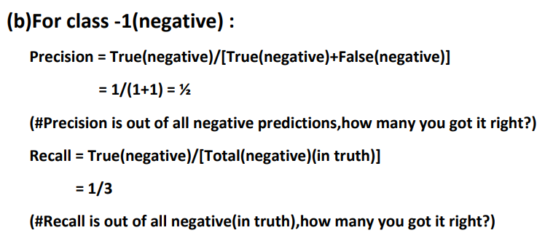
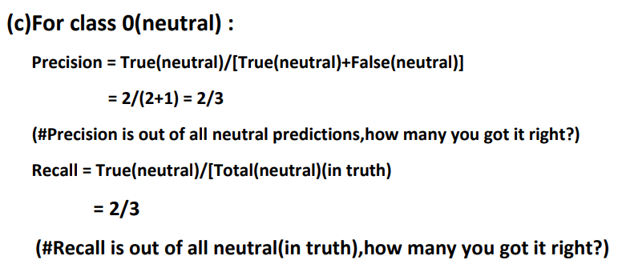
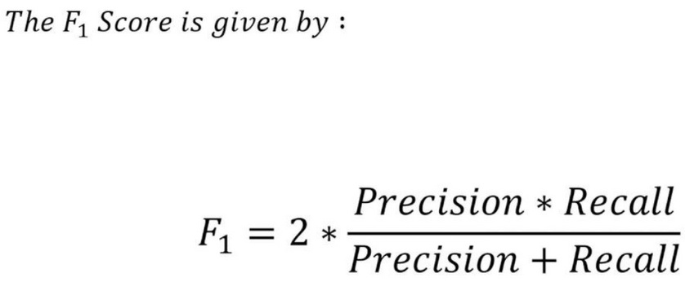

Slide 19
MULTINOMIAL NAIVE BAYES'
Multinomial Naive Bayes is a variant of the Naive Bayes algorithm that is commonly used for text classification problems, where the features are discrete counts (such as the counts of words in a document) rather than continuous numerical values.
In Multinomial Naive Bayes, the assumption is that the probability distribution of the features (i.e., the word counts) for each class follows a multinomial distribution. In other words, each class has a probability distribution over the different possible feature values, and this distribution is estimated from the training data.
During training, the algorithm estimates the probability distribution of the features for each class by counting the number of occurrences of each feature in the training documents of that class. These counts are then smoothed using techniques such as Laplace smoothing to avoid zero probabilities.
During prediction, the algorithm calculates the probability of the document belonging to each class using Bayes' theorem and the estimated probability distributions. The class with the highest probability is then selected as the predicted class.
PAUCEK AND LAGE

Slide 20
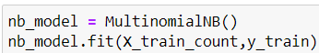
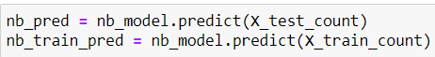
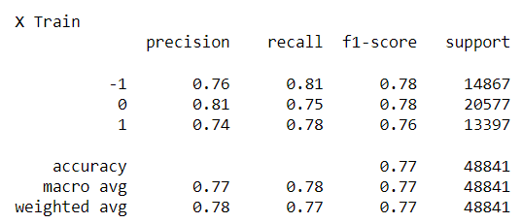
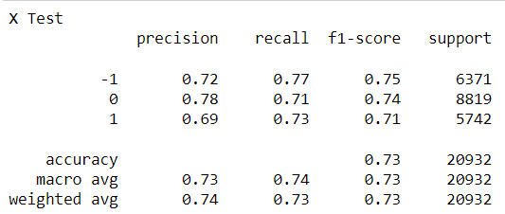
MODEL EVALUATION
(a)On training data
(b)On testing data

Slide 21
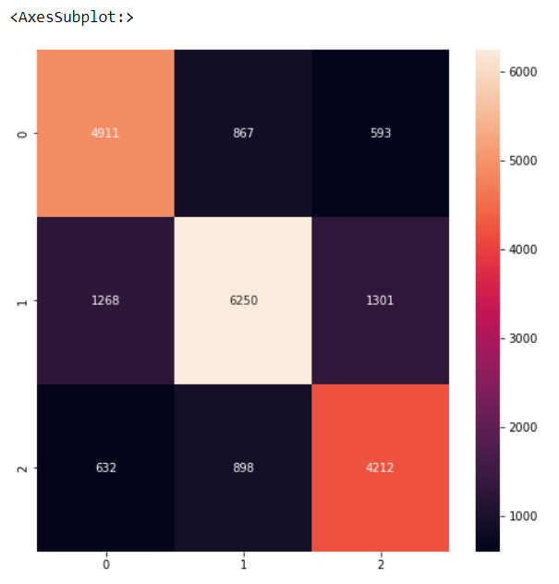
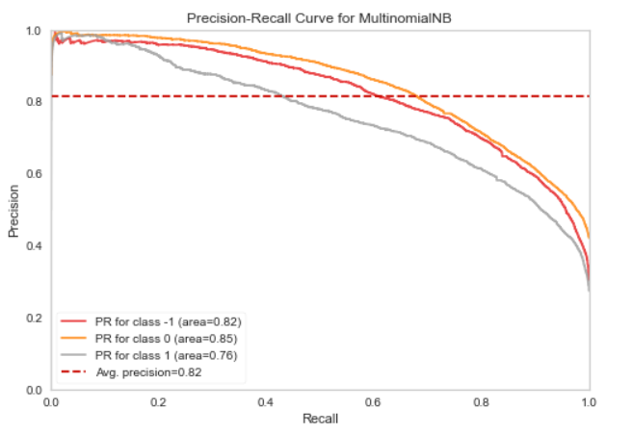
(b). Confusion Matrix
(c). Precision recall curve

Slide 22
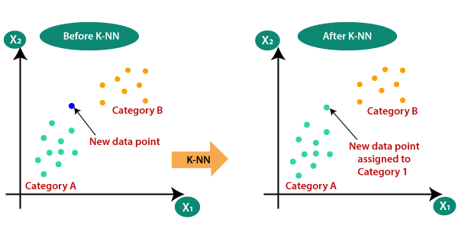
KNN(K-NEAREST NEIGHBOR)
K-NN algorithm stores all the available data and classifies a new data point based on the similarity. This means when new data appears then it can be easily classified into a well suite category by using K- NN algorithm.
PAUCEK AND LAGE

Slide 23
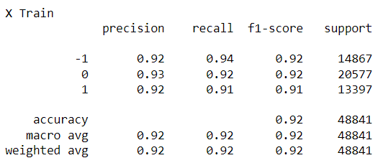
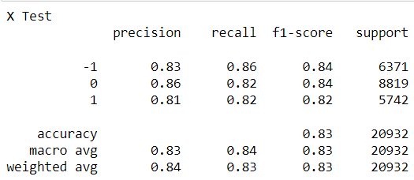
MODEL EVALUATION
(a)On training data
(b)On testing data

Slide 24
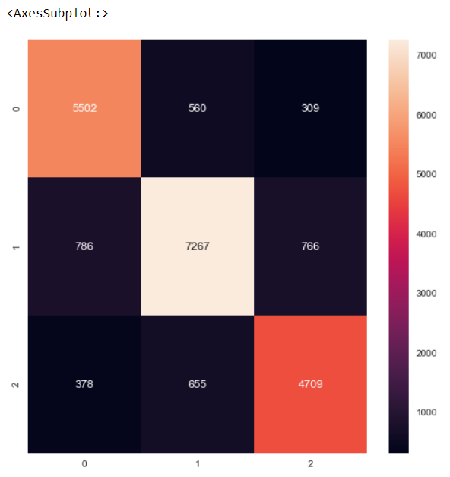
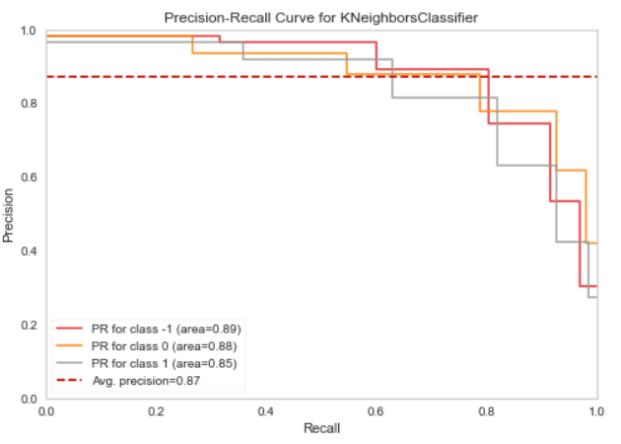
(b). Confusion Matrix
(c). Precision recall curve
“Before we used the services provided by this

Slide 25
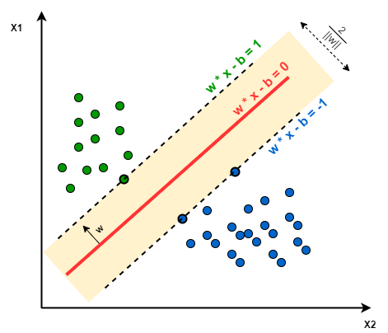
SVM(SUPPORT VECTOR MACHINE)
SVM tries to find a line that maximizes the separation between a two-class data set of 2-dimensional space points. To generalize, the objective is to find a hyperplane that maximizes the separation of the data points to their potential classes in an n-dimensional space. The data points with the minimum distance to the hyperplane (closest points) are called Support Vectors.
Red line is hyperplane
Scattered lines are margine
There are three support vector 2 is blue and 1 is green toching scatter line

Slide 26
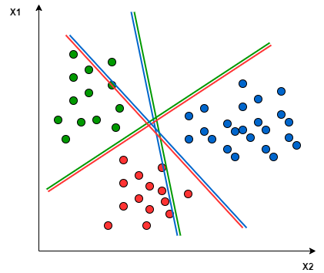
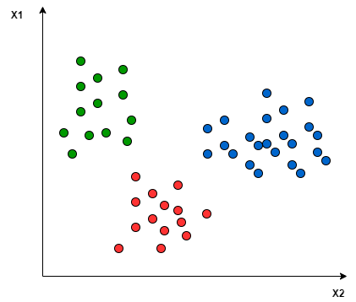
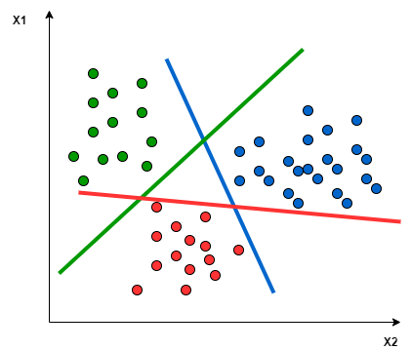
One-to-One approach
One-to-Rest approach

Slide 27
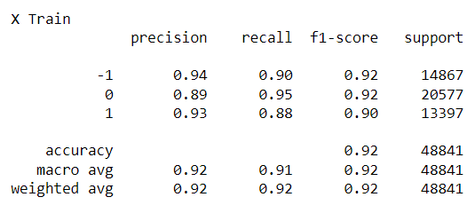
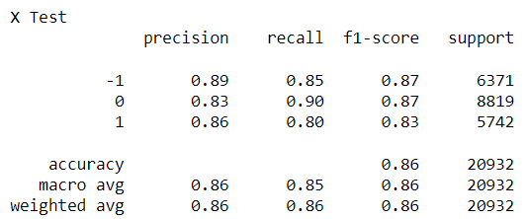
MODEL EVALUATION
(a)On training data
(b)On testing data

Slide 28
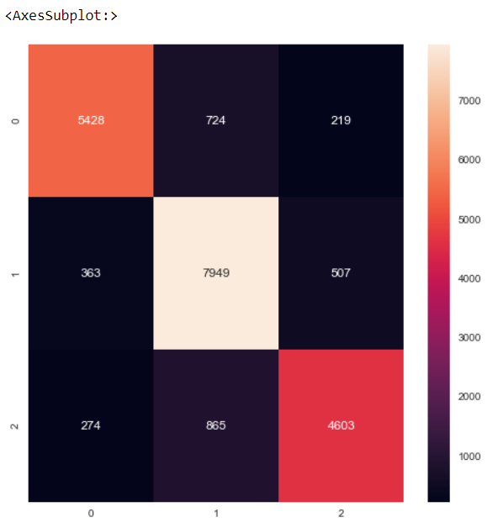
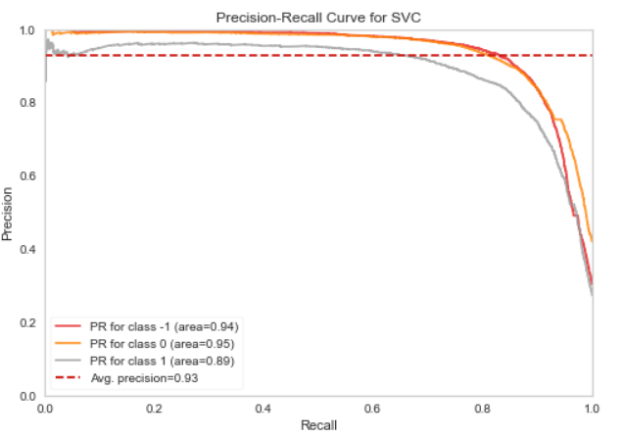
(b). Confusion Matrix
(c). Precision recall curve

Slide 29
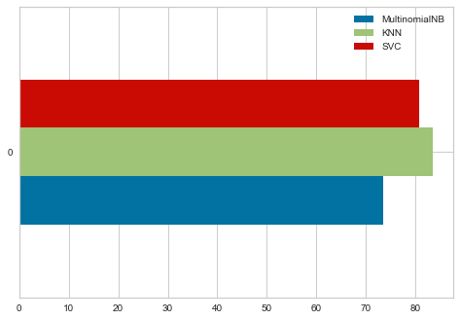
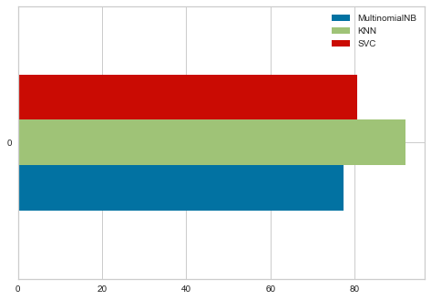
COMPARISON BETWEEN ALL
(a)On testing data
(b)On training data

Slide 30
CONCLUSION
Twitter Sentimental Analysis is used to identify as well as classify the sentiments that are expressed in the text source.
MultinomialNB, KNN, and SVC are some of the ML algorithms that can be used for Twitter Sentimental Analysis.
After observing the accuracy of each classification algorithm, we can conclude that the model which is trained on KNN has the highest accuracy of 92% on training data.

Slide 31
REFERENCES
Brijesh Bakariya and G.S. Thakur, "An Efficient Algorithm for Extracting Infrequent Itemsets from Weblog", The International Arab Journal of Information Technology (IAJIT),2019 (2)
Meylan Wongkar , Apriandy Angdresey, “Sentiment Analysis Using Naive Bayes Algorithm Of The Data Crawler: Twitter”, 2019 Fourth International Conference on Informatics and Computing (ICIC).
Aliza Sarlan, Chayanit Nadam, Shuib Basri, “Twitter Sentiment Analysis”, International Conference on Information Technology and Multimedia (ICIMU) 2014.
Ms.R.Monika, Dr.S.Deivalakshmi, Dr.B.Janet, “Sentiment Analysis of US Airlines Tweets using LSTM/RNN”, IEEE 9th International Conference on Advanced Computing (IACC) 2019.
Brijesh Bakariya and G.S. Thakur, "Mining Rare Itemsets from Weblog Data",National Academy Science Letters, 2015 page 1-5.

Slide 32
2
THANK YOU

